Slide 1
THE FACES OF MICROCREDIT The Arizona Rotary, Sonora Mexico,FinReg Program

Slide 2
World Poverty, Immigration & Gumballs

Slide 3
FinReg Office

Slide 4
Hermosillo Pitic meeting

Slide 5
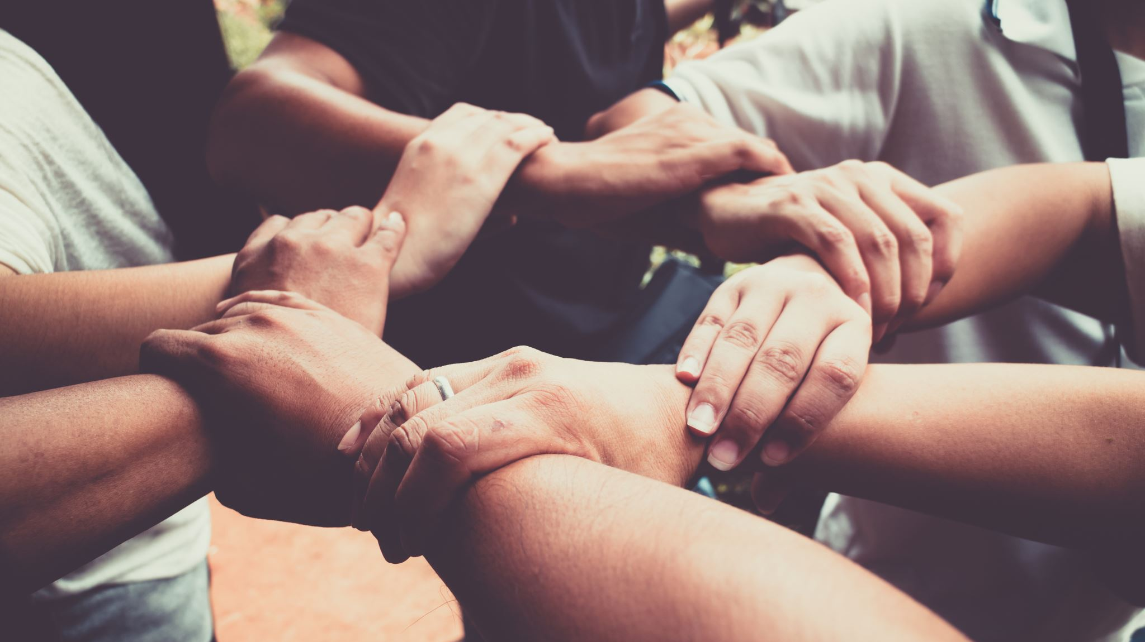
THE ‘UNBANKED’
THE STORIES AND SUCCESSES
OF OUR BORROWERS

Slide 6
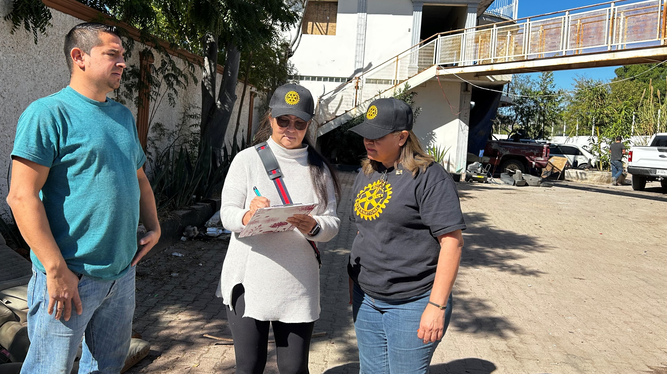
Gustavo Abraham-Car Detailing
10 Years in the Business, 4 Cycles, 1ST Loan: 5,000 Pesos, Current: 4,000 Pesos

Slide 8
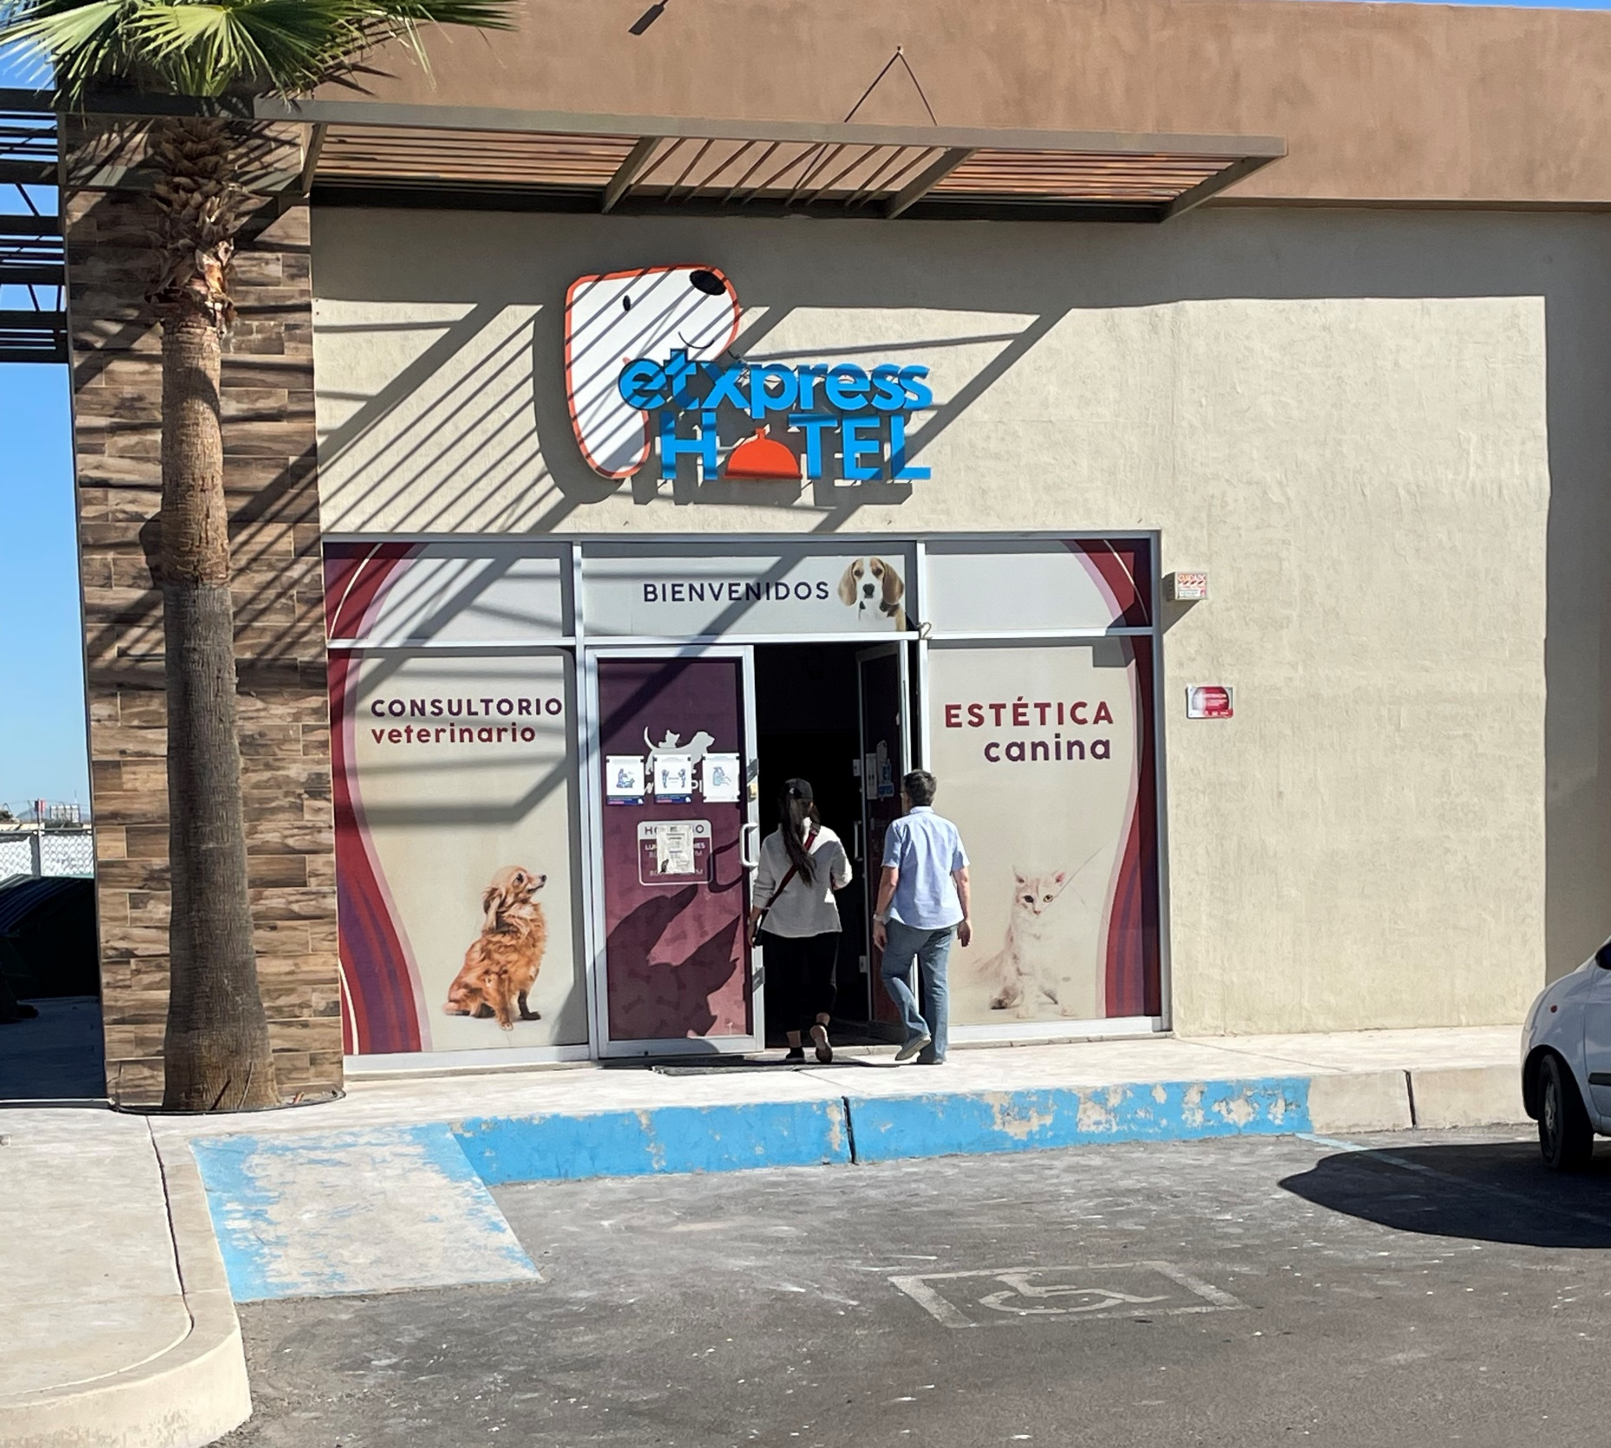
MARIA MARTINEZ
Dog Hotel,
Pet Grooming,
Vet Services, Pet Parties, Cakes and Cookies

Slide 9
Maria, 26 Years Old, 2 Years in Business, 2 Cycles 1ST Loan: 5,000 Pesos, 2ND Loan: 8,900 Pesos

Slide 10
Maria Acosta Optometrist

Slide 11
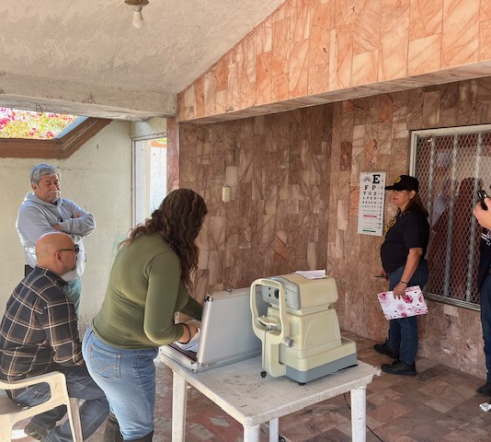
12 Years in Business
4 CYCLES
1ST Loan: 5,000 Pesos
Current Loan: 20,000 Pesos

Slide 14
Angel Camontes, 14 Years in Business, 19 Cycles 1ST Loan: 5,000 Pesos, 19TH Loan 40,000 Pesos

Slide 15
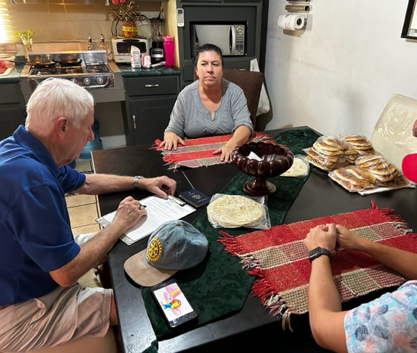
Reyna Beronia
Makes Tamales, Tortillas, Empañadas and Cookies
In Business 24 Years
14 Cycles
1ST Loan: 5,000 Pesos
Current Loan: 7,000 Pesos

Slide 16
Teresa Moreno

Slide 17
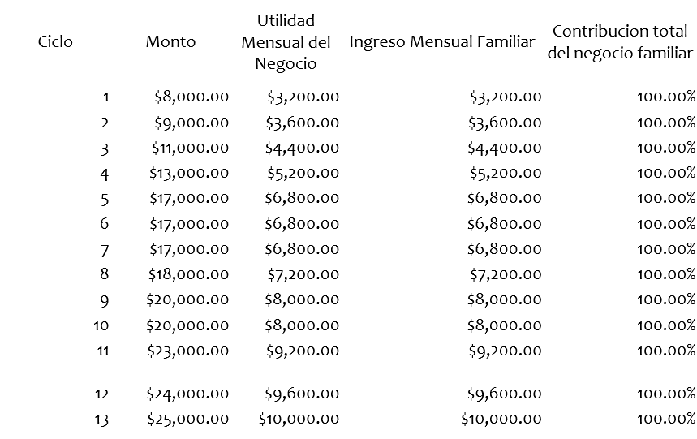
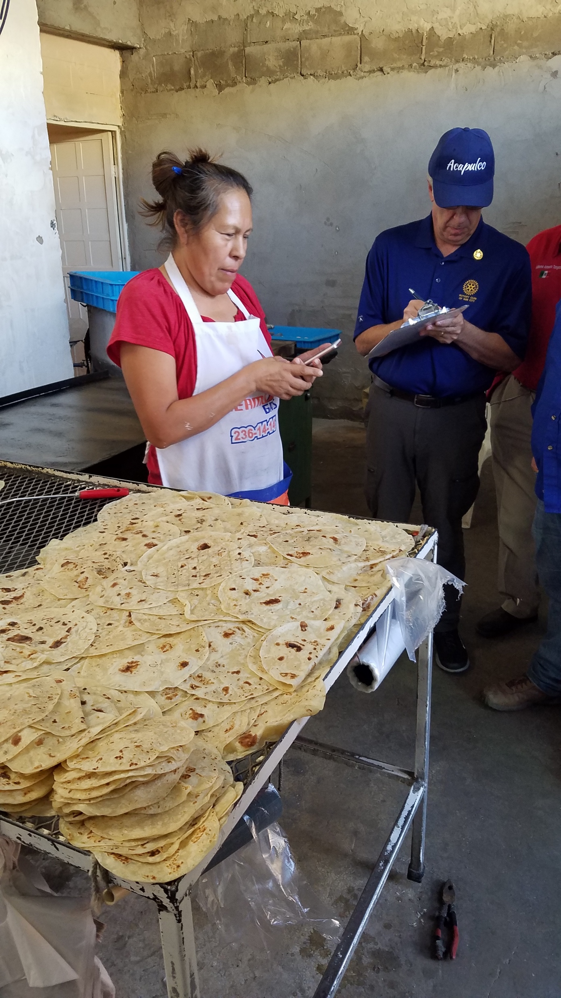
Teresa Amparano Moreno
61 Años
Elaboración y Venta de Tortillas de Harina

Slide 18
Lorena Morales-Pinata Maker In Business 15 Years, 5 Cycles 1st Loan: 5,000 Pesos, Current Loan: 15,000 Pesos

Slide 20
LOAN INFORMATION NOVEMBER 2024
 | Hermosillo |  | Nogales
 | GG14 | GG15 | GG16 | Rotary AZ Microcredits
Initial Loan Amount | 1,656,900 Pesos ($105,000) | 1,550,848 Pesos ($83,200) | 1,693,393 Pesos ($88,892) | 983,163 Pesos ($50,007) *
# Loan Cycles | 16 | 14 | 12 | 2
Amount Loaned | 34,160,000 Pesos | 24,194,000 Pesos | 23,167,080 Pesos | 419,000 Pesos
30 Days Delinquent | 0.74% | 0.67% | 0.65%
60 Days Delinquent | 0.83% | 0.84% | 0.67%
90 Days Delinquent | 0.81% | 0.91% | 0.69%
120 Days Delinquent | 0.75% | 1.04% | 0.57%
Total Clients | 5,474 | 4,179 | 3,242 | 130
Outstanding Average Loan Amount | 12,458 Pesos (~$608) | 18,810 Pesos (~$918) | 14,887 Pesos (~$728) | 15,061 Pesos (~$736)
* $25,621 added 1/5/25
Total Program Funds: $352,720

Slide 21
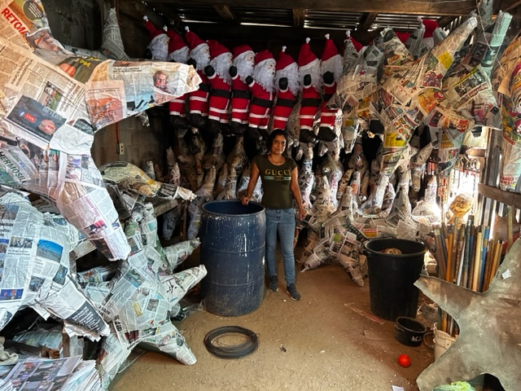
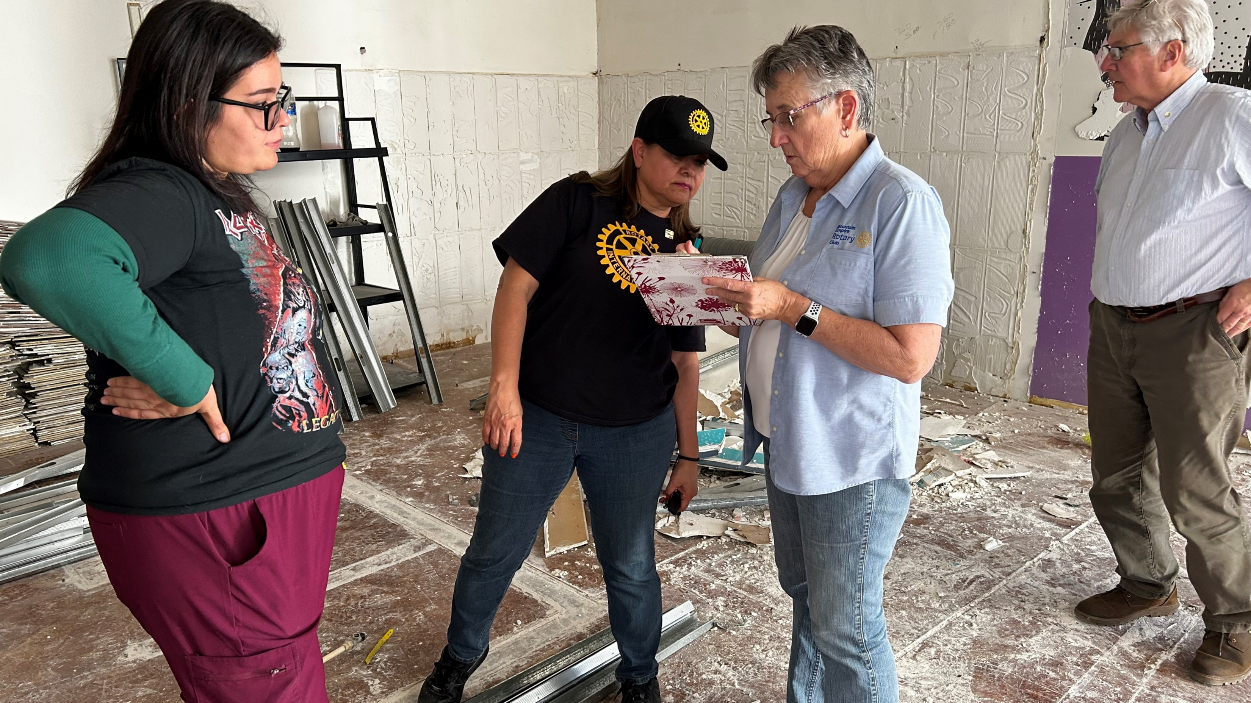
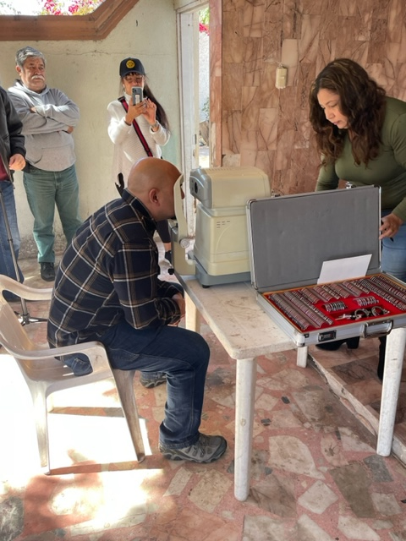
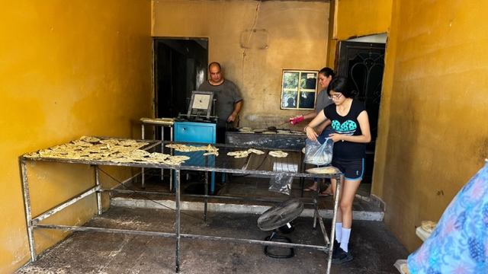
How This Program Works
Other Rotary Clubs
Individual Donors
Tempe South Rotary
Foundation
Cycles

Slide 22
How This Program Works
1-3 Rotary Global Grants create the initial operating capital
2-Additional operating capital is provided by donations from individuals (tax deductible) and Rotary Clubs in AZ
3-Borrower groups (5-12 members) are formed by FinReg
4-Loans are approved and administered by FinReg staff
5-Borrower trips are created by the Rotary Microcredit Committee and costs are covered by FinReg
6-Borrower surveys are taken by individuals on the visit-statistical data is collected and reviewed
7-Monthly financial data is collected by FinReg and reviewed by the Microcredit Committee

Slide 23
QUESTIONS & ANSWERS
More information? Please contact:
Program Chair D5495 PDG Abe Feder 602-622-7289 abefeder1@gmail.com
D5500 D5500 Leo Lawrenson, 678-777-0324 Leo@Lawrenson.com
Join us on our next borrower’s trips
February 21-23 and March 28-30, 2025

